Slide 1
Equality for all? Disparities in Latino Justice
Cynthia Willis Esqueda, PhD
University of Nebraska-Lincoln
Department of Psychology
Institute for Ethnic Studies
Social and Cognitive Psychology Program
Psychology and Law Program
April 8, 2016

Slide 2
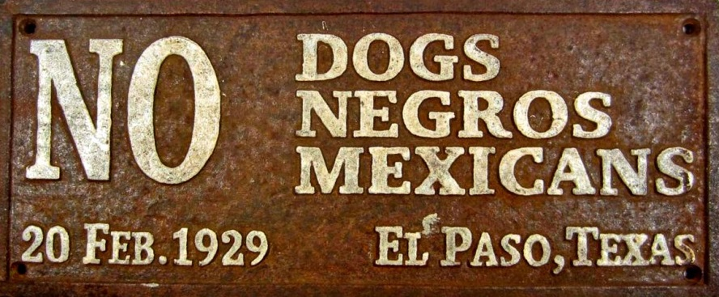
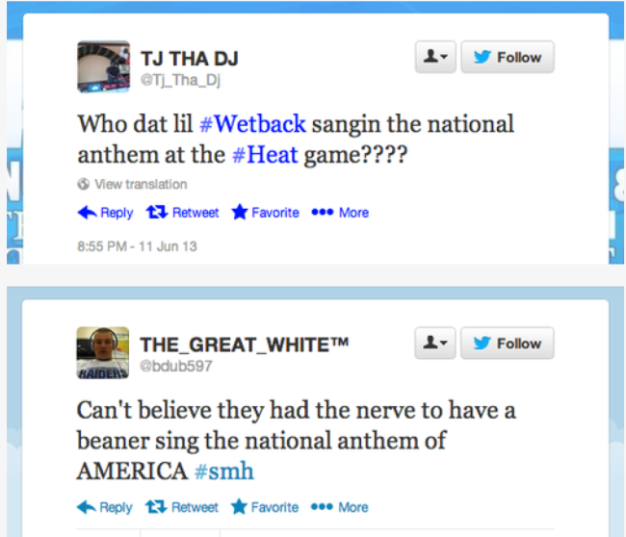
Historical Background
Population Information
Findings on Biases
Modern Attitudes & Current Research
Not Covered
Immigration Attitudes and Ideology
Immigration Issues and Mental Health
Migrant and child worker issues
Civil law issues
Notes:
Today, I want to provide historical background, population information, talk about findings on bias from my lab, and mention modern attitudes that influence bias against Latinos in the legal system.

Slide 3
Societal Behaviors and Norms
Blatant/Subtle Racism
Racism Individual
Institutional
Cultural
Racial Stereotypes
(Explicit/Implicit)
Motivations
Racial Disparities
Legal Processes
Criminal and Civil, Immigration Law,
Discrimination Law, etc.
Arrest
Prosecution
Trial/Disposition
Sentencing
Parole
Notes:
Most research on race bias fits into a model that predicts racial disparities. AS you can see, the model is complicated. Hence, the difficulty in developing a simple, comprehensive explanation for race disparities.

Slide 4
Anti-Latino Attitudes are Not New
Santa Barbara Gazette (1856).
Native Mexican population “…are habitually and universally opposed to all progress whatsoever, and they look with decided disfavor upon every innovation which tends in the slightest degree to alter the old hereditary regime which existed under the Mexican government”.
El Paso Bureau of Information (1886).
“Progress has not characterized El Paso, due to the presence of the Mexican population. More Whites are needed in the town”.
1910 – US Congressional Debates on Arizona and New Mexico Statehood. South Carolina Senator Blease stated, Arizona’s opposition to joint statehood was “…a cry of pure blooded white community against the domination of a mixed breed aggregation of citizens of New Mexico who are Spanish, Indians, Greasers, Mexicans, and everything else”.
Notes:
Anti-Latino bias is not new. My favorite quote comes from S C senator Blease, who stated, Arizona’s opposition to joint statehood was “…a cry of pure blooded white community against the domination of a mixed breed aggregation of citizens of New Mexico who are Spanish, Indians, Greasers, Mexicans, and everything else”.

Slide 5
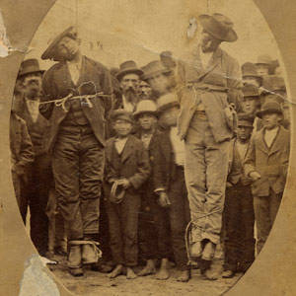
Past Overt/Explicit Legal Bias
Carrigan & Webb (2015)
“When Americans Lynched Mexicans”
Like Blacks, thousands of mob lynchings of Mexicans 1848-1928
Delgado (2009)
Like Blacks, “acting “uppity,” taking away jobs, making advances toward a white woman, cheating at cards, practicing “witchcraft,” and refusing to leave land that Anglos coveted.”
Exception - 14 Mexicans were lynched for acting “too Mexican” - speaking Spanish too loudly or reminding Anglos of their Mexicanness.
Difference from Blacks, law enforcement was often part of the mob.
Francisco Arias and José Chamales
Notes:
Past overt bias against Latinos in the system is not new either. Like blacks, thousands of Mexicans were lynched.

Slide 6
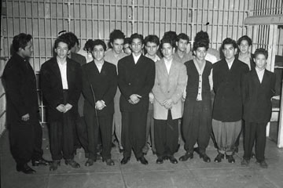
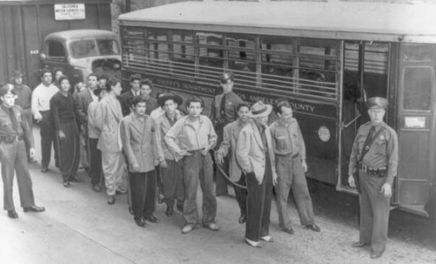
Sleepy Lagoon Trial – Infamous Case of Bias
People v. Zamora (1942) - the largest mass trial in California history.
The day after a fight between a White gang (Downy Boys) and Mexican American gang (38th Street), Jose Diaz is found dead near Sleepy Lagoon lake.
600 Mexican American youth rounded up by the LAPD.
17 were accused of the murder of José Díaz.
Notes:
The most famous case of bias, comes from People v. Zamora, commonly called the sleepy lagoon case. It was the largest mass trial in CA history. After a fight between rival neighborhoods, Jose Diaz was found dead. LA police rounded up 600 Mexican American Youth for questioning. 17 are charged with murder.

Slide 7
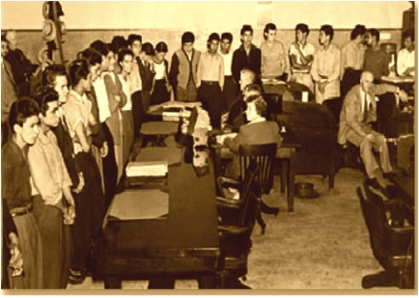
The Trial
At trial, lawyers could not confer with defendant clients.
Defendants were not allowed to cut their hair or have clean clothes – but the prosecution used their hair and clothes as evidence of guilt.
The judge referred to their appearance as their true “character”.
The judge allowed a member of the Los Angeles sheriff's office, E. Duran Ayres, to testify as an "expert witness" that Mexicans as a community had a "blood thirst" and a "biological predisposition" to crime and killing, citing the culture of human sacrifice practiced by their Aztec ancestors
Young men from 38th Street ring the trial room for arraignment. (Herald Examiner Collection, L.A. Public Library)
Notes:
At trial, the attorney could not confer with clients, the defendants couldn’t cut their hair or change their clothes (but this was used as evidence of their criminal character). A LA sheriff’s office employee acted as an expert and testified Mexicans had a "blood thirst" and a "biological predisposition" to crime and killing, citing the culture of their Aztec ancestors.

Slide 8
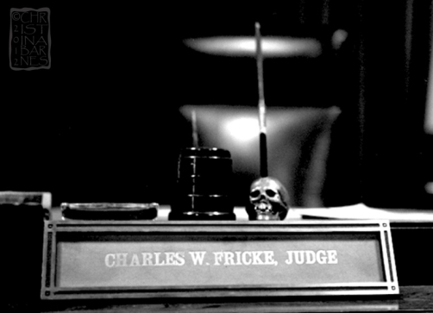
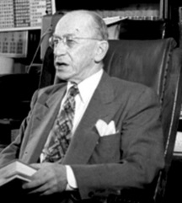
The Conviction
On January 12, 1943 the court (presided by Judge Charles Fricke) found 17 defendants guilty – 12 of murder.
On federal appeal in October of 1944, Judge Clement Nye overturned the verdicts of the case citing insufficient evidence, the denial of the defendants’ right to counsel, and the overt bias of Judge Fricke in the courtroom.
Notes:
All 17 were found guilty, but only 12 of murder. On appeal, the case was overturned due to a lack of evidence, denial of atty access, and the judge’s bias.

Slide 9
Past Research on Latinos and Legal System
U.S. Commission on Civil Rights (1970). System wide abuse. Mexican Americans and the Administration Justice in the Southwest. Found widespread reports of profiling, police brutality, and irregular legal practices.
Lipton (1983). Jury composition. Main effect of juror ethnicity. The Chicano defendant was found more guilty, liked less, thought less intelligent, and more dishonest by White jurors than by Chicano ones.
Bodenhausen & Lichenstein (1987). Evidence. Subjects with a (complex) guilt judgment objective judged the defendant to be relatively more guilty and aggressive and recalled more negative information about him if he was Hispanic than if he was ethnically nondescript.
Hosch, et al. (1993). Judges. Hispanic judges sentenced equally. White judges sentenced Hispanics more severely compared to Whites.
Demuth & Steffensmeir (2004). Sentencing. Hispanics receive harsher sentences, compared to Whites.
Notes:
Past research has shown bias as well. By 1970, the US commission on civil rights found wide spread abuse against Mexican Americans in the Southwest. Moreover, research has been conducted on jury composition, use of evidence, judges behaviors, and sentencing.

Slide 10
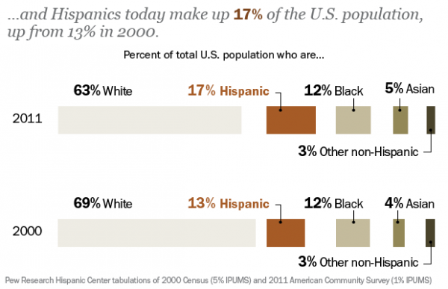
Current Latino Population makes an understanding of bias in the legal system important.
Notes:
The face that Latinos are the number one minority group makes legal system bias against them important.

Slide 11
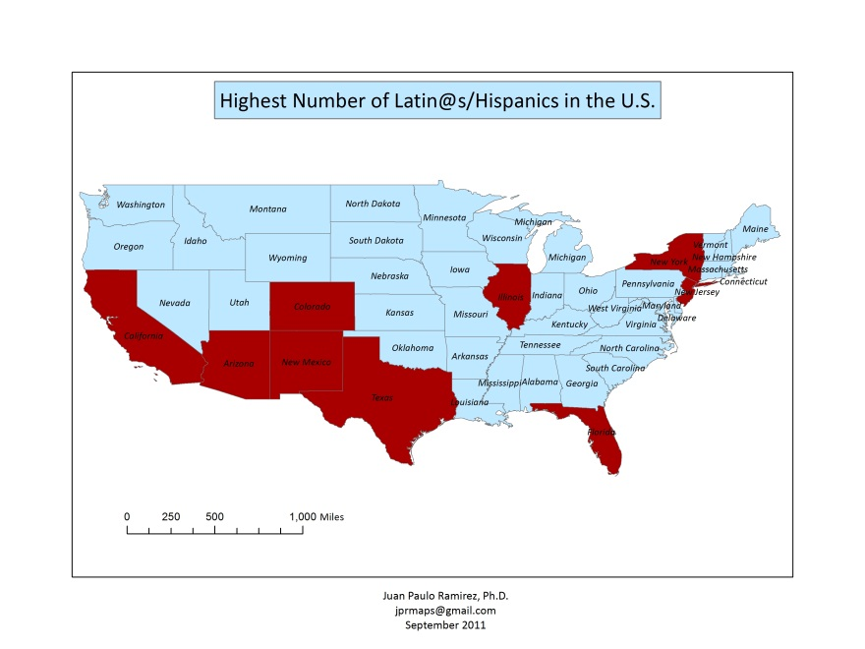
Over ¾ of Hispanics live in 9 states: Arizona, California, Colorado, Florida, Illinois, New Mexico, New Jersey, New York and Texas
Notes:
Most Hispanics live in just 9 states in the US.

Slide 12
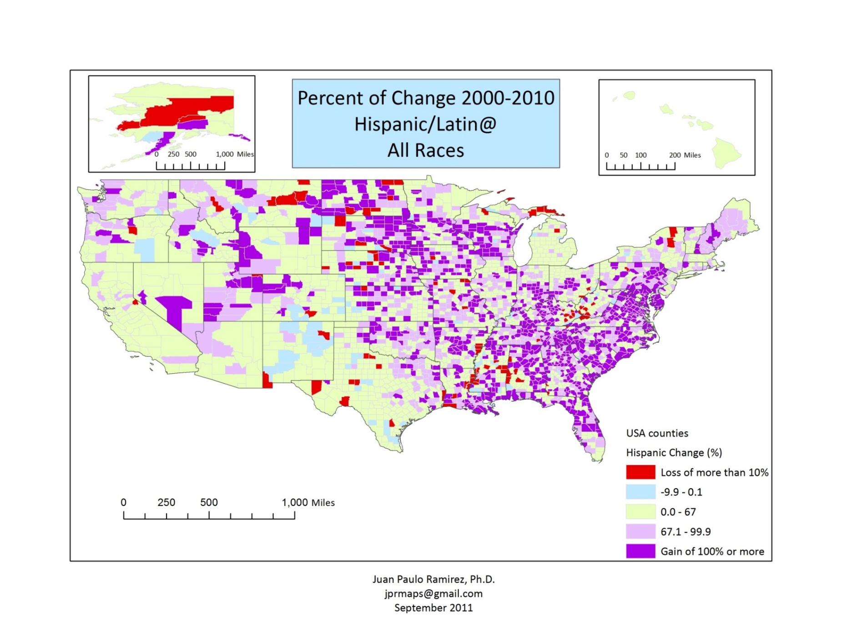
Nebraska has experienced over 300% increase in Latinos in some counties.
Notes:
However, parts of the US have seen tremendous increases in the Latino population. In parts of Nebraska, there have been entire small towns that are now majority Latinos and counties with a 300% increase in Latinos.

Slide 13
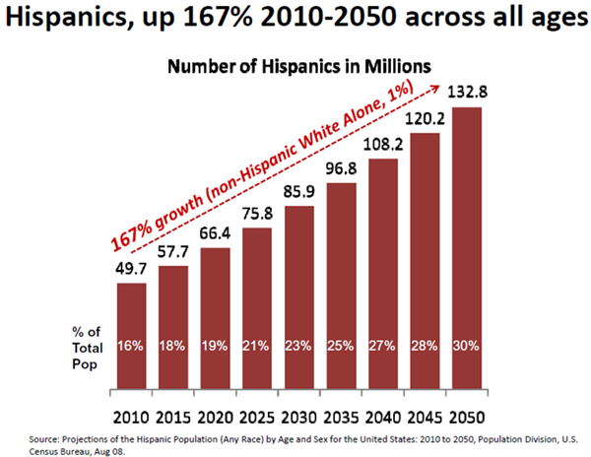
Latino Population is expected to reach 30% of the total by 2050.
Notes:
By 2050, estimates are that nearly 1 of 3 people will be Latino.

Slide 14
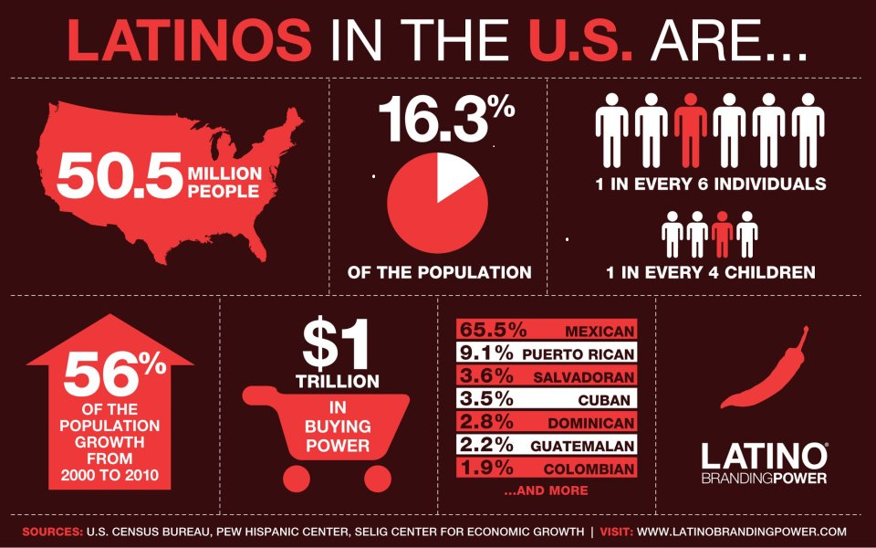

Slide 15
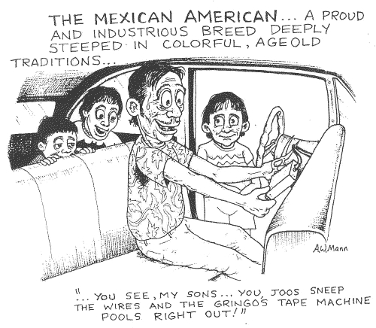
Race Bias Research in the Legal System
Compared 5 ethnic groups.
Hispanics = Blacks
Violent and Victim Crimes
Armed robbery
Assault/mugging
Rape
Murder
IPV
Vice Crimes
Narcotic sales
Narcotic possession
Willis Esqueda (1997).
Notes:
I have always been interested in race disparities in the legal system, but I realized I needed to know what crimes are stereotypically linked to what groups in order to do research. So, a while ago I found that Hispanics and Blacks are thought to commit the same types of offenses – violence and victim crimes, and vice crimes, compared to other groups.

Slide 16
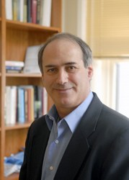
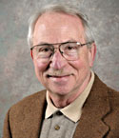
Aversive Racism Theory (Dovidio & Gaertner, 1986; 2007)
AR’s are defined by constellation of features
1. ARs endorse fair treatment of all groups.
2. Despite good intentions, ARs harbor negative feelings toward Blacks.
3. They don’t want to appear to be prejudiced.
5. Negative feelings get expressed, but in subtle, rationalizable ways that disadvantage the targeted group.
Notes:
Aversive racism theory provides a framework to understand current biases against Latinos in decision making.
1. ARs endorse fair treatment of all groups.
2. Despite good intentions, ARs harbor negative feelings toward Blacks.
3. They don’t want to appear to be prejudiced.
5. Negative feelings get expressed, but in subtle, rationalizable ways that disadvantage the targeted group.

Slide 17
Based on aversive racism theory we examined the influence of non-race related cues (e.g., SES) on culpability assignment for Mexican Americans (MAs) compared to Whites.
2 studies: University of Nebraska-Lincoln and University of Texas, El Paso
Varied: Defendant Race, Defendant SES, and Social Status of crime (art theft versus car theft).
Procedure: Participants read a hard copy transcript and filled out a questionnaire.
Results
With Whites at UNL, for low SES Mexican Americans, there is a culpability bias, compared to those high in SES or to European Americans. No effects for Mexican Americans at UTEP.
Willis Esqueda, C., Espinoza, R. K. E., & Culhane, S. (2008).
Notes:
Based on aversive racism theory we have examined the influence of non-race related cues (e.g., SES) on culpability assignment for Mexican Americans (MAs) compared to Whites.
We conducted 2 studies – one at UNL and one at UTEP. We believed that the inclusion of SES status and the status of the crime might produce bias against a Latino defendant. In other words, is it race or SES or type of crime that produces biases?
And, we found that Whites at UNL, gave the low SES Mexican American biased culpability assessments, compared to the Mexican American HIGH in SES or Whites. There were no effects for Mexican American participants at UTEP.

Slide 18
Ethnicity of Defendant
Mexican American European American
________________________________________________
SES Level Low SES High SES Low SES High SES
______________________________________________________________
Responsibility 6.87a 4.54b 5.37b 4.39b
Blame defendant 6.97a 4.79b 5.07b 4.63b
Believe defendant 3.35b 4.98a 5.05a 4.61a
______________________________________________________________
Not Guilty 16a 33b 32b 35b
Guilt 39a 19b 25b 22b
Note: Means in the same row that do not share a subscript differ at the p < .05. SES = socioeconomic status.
Sentencing followed the same pattern of results. Personal traits were more negative.
Notes:
So, for responsibility, blame, belief, and verdict, low SES Mexicans received biased assessments.

Slide 19
MA Defendants, MA Attorneys, and SES
Online data collection with UNL, White students.
Replication. For low SES Mexican Americans, there is a culpability bias, compared to those high in SES or to European Americans.
MA Attorneys were denigrated, and Attorneys who represent low SES Mexican Americans are thought to be less competent
Espinoza, R. K. E., & Willis Esqueda, C. (2008).
Notes:
Next, we wondered if the effect could be replicated, and would the bias SMEAR onto the attorney who represented the low SES Mexican American defendant. Using the same procedures as before, we also varied the race of the attorney – either Mexican American or White.
We replicated the earlier results for the low SES Mexican American defendant, but the Mexican American Attorney was also denigrated. Their client was thought more responsible and had more intent.

Slide 20
How much do you believe the defendant?
How much do you blame defendant?
Notes:
However, the combination of a low SES, Mexican American defendant and a Mexican American Attorney demonstrated bias. Participants believed the low SES Mexican American defendant with a Mexican American attorney less and blamed him more.

Slide 21
Can The Death Penalty Serve as Justice?
Participants
561 venire persons (White = 286, Latina/o = 275, M age = 37.92 years, Males = 305, Females = 256) who were called for jury duty at a County Courthouse in CA acted as mock jurors.
Procedures
After being released from jury duty, they agreed to participate and arrived for the session in a room in the Courthouse.
They read a first degree murder case transcript where defendant varied by:
Race: Mexican American or White SES: Low or High Mitigating information: Weak or Strong
They rendered a verdict, recommended a sentence, and provided culpability ratings.
Participants were “death qualified”. All participants answered NO to the questions, “Do you feel so strongly about the death penalty that it would prevent or substantially impair your performance of juror duties?” and “Would you ever be unable to agree to a death sentence, if the law required it?”
Espinoza, R. K. E., & Willis Esqueda, C. (2015).
Note: We were only interested in European American and Latino juror decision making, so we did not examine responses for other ethnic groups (37 African-American, 44 Asian, and 24 who identified as “Other”).
Notes:
Well, would this occur for the ultimate type of offense, a capital offense? This time we ran the study in CA with actual White and Latino jurors who were exiting a venire. We had them act as a juror and read a murder case. We varied the race of defendant (MA or White), the SES (Low or High) and the type of mitigating information (weak or strong).
Participants provided a verdict, a sentence (death or prison sentence) and culpability ratings.

Slide 22
Results
No differences by guilt verdict (Guilty versus Not Guilty) – Guilt prone.
Whites’ Sentencing gave the Hispanic, low SES, Weak mitigating condition → highest number of death decisions.
Loglinear Analysis, 3-way interaction, X² (12) = 39.67, p < .001
Notes:
While all participants were guilt prone, Sentencing by White participants demonstrated bias. The Hispanic, low ses, weak mitigating condition received the highest number of death sentences, and the White, high ses, strong mitigating condition received the most prison sentences.

Slide 23
Death, cont.
Manova for Whites’ Culpability Ratings
The low SES, weak mitigation Latino, was held more responsible, more blameworthy, more intent, more vicious, compared to other conditions.
How responsible is the defendant for committing this crime? F (7, 278) = 2.54, p < .05 η² = .06.
How much blame should the defendant receive? F (7, 278) = 7.63, p < .001, η² = .16
Did the defendant intentionally commit the crime? F (7, 278) = 2.16, p < .05, η² = .05
How much did the viciousness impact your decision? F (7, 278) = 2.25, p < .05, η² = .05
Latino jurors did not show bias.
Notes:
Moreover, the Hispanic with low ses and weak mitigating information was held more culpable on a variety of measures. Latino jurors showed no bias in sentencing or culpability assignment.

Slide 24
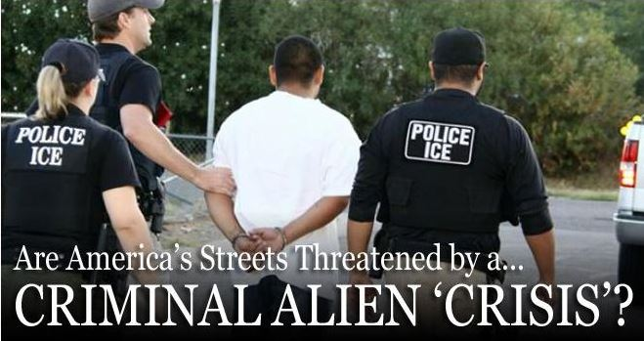
Ethnic Immigration Status and SES: When Does Justice Begin?
Participants:
320 White Venire Persons from County Courthouse in CA. After jury service they volunteered for participation.
Procedure:
Read a transcript of a second degree murder trial that varied Defendant:
Race: Mexican National or White Canadian
Immigrant Status: Undocumented or Documented
SES: Low or High
Completed Ratings Measures:
Verdict (Guilty/Not Guilty)
Sentence (prison w/ parole or prison no parole)
Culpability (Responsibility, Blame, Intentionality, etc.) 1-7 rating scales
Trait ascriptions (Trustworthy, Like, Selfish, Intelligence, Warm, etc.)
Espinoza, R. K. E., Willis Esqueda, C., Toscano, S., & Coons, J. (2015).

Slide 25
Verdict by Race, Immigration Status, and SES
NG = Not Guilty Verdict G = Guilty Verdict

Slide 26
Sentence by Race, Immigration Status, and SES

Slide 27
Why is there Bias? Modern Anti-Latino Attitudes
AP Poll - Most Americans express anti-Hispanic feelings. In an AP survey from 2011, 52 percent of non-Hispanic whites expressed anti-Hispanic attitudes. That figure rose to 57 percent in an implicit test.
By The Associated Press
October 27, 2012
http://usnews.nbcnews.com/_news/2012/10/27/14740413-ap-poll-majority-harbor-prejudice-against-blacks?lite
PEW Center Poll - For many non-Latino Americans, the words “Latino” and “illegal immigrant” are one and the same. A 2012 poll found over 30 percent of non-Latinos believe a majority (over half) of Latinos are undocumented. The actual figure of undocumented Hispanics in the U.S. is around 18 percent, and only 37 percent of U.S. Hispanics are actually immigrants, according to the Pew Hispanic Center.
by Sandra Lilley, @sandralilley 09/12/2012
http://nbclatino.com/2012/09/12/poll-1-out-of-3-americans-think-most-hispanics-are-undocumented/

Slide 28
Willis-Esqueda & Davila Martinez (unpublished data).
Ethnic Identity and Social Distance
Whites preferred:
General Social Distance*
EA (M = 1.26) MA (M = 2.45) p < .001
Interpersonal Social Distance
EA (M = 1.45) MA (M = 3.40) p < .001
Living Social Distance
EA (M = 1.09) MA (M = 2.40) p < .001
* Note: 36 Items with 6 point rating scales after Bogardus (1928). Larger means indicate larger social distance.

Slide 29
Helms White Identity Scale
Racial Superiority predicted General SD, Interpersonal SD, and Living Proximity SD. Cross Race Competence/Comfort only predicted Interpersonal SD.

Slide 30
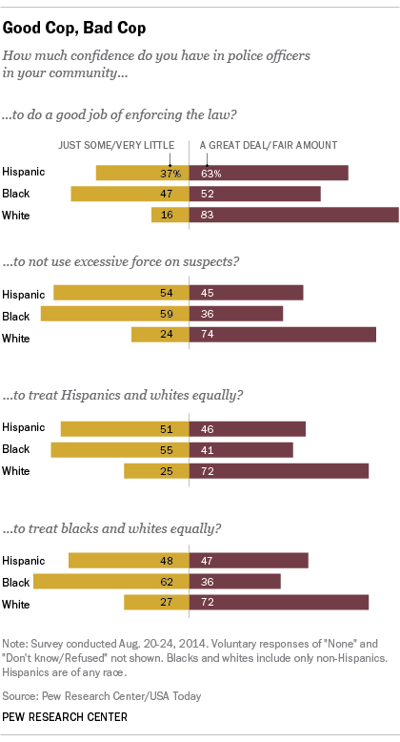
Krogstad, 2014, Aug. 28.
Notes:
Hispanics and Blacks both have more negative attitudes about police officers and justice.

Slide 31
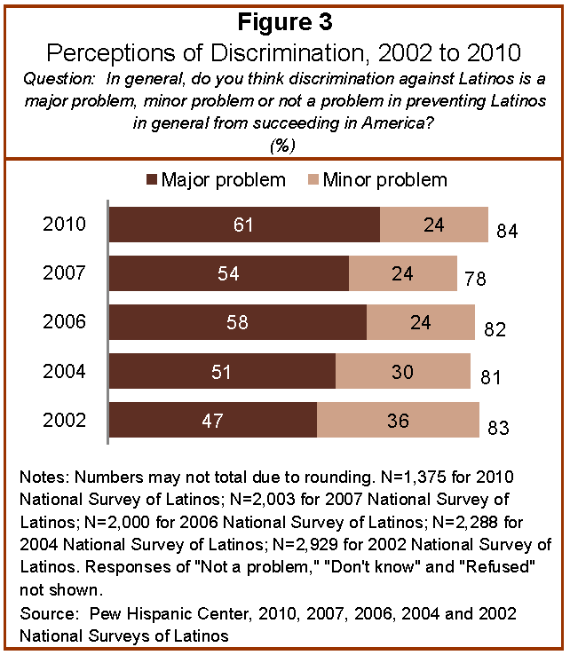
Notes:
And, Latinos are more likely to believe that discrimination is a major problem.

Slide 32
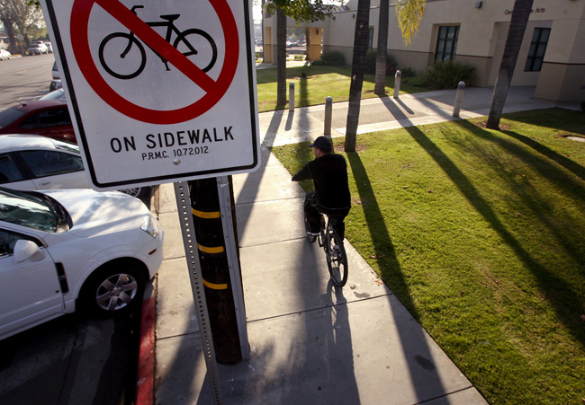
Current Research – Minor Infractions
We have a preliminary study on bias against Latinos who commit Minor Infractions.
bicycling on the sidewalk
jaywalking
control – walking fast
Measured:
Culpability
Justification for the Stop
Minority and White Participants
Preliminary results:
Participants all report they have committed these acts
Latinos are thought more culpable
It is thought more appropriate to make a stop with Latinos

Slide 33
Current Research – Stressors and Coping
We are examining stressors (encounters with Law Enforcement) for influence on psychological dysfunction and coping.
Rural and Urban Latinos (N = 71).
Complete surveys on stressors, K6 psych dysfunction, and COPE.
Preliminary Results
Encounters with Law Enforcement → Psych Dysfunction
Encounters with Law Enforcement → Coping Behaviors
Feelings of Nervousness at Thought of Police → Coping Behaviors

Slide 34
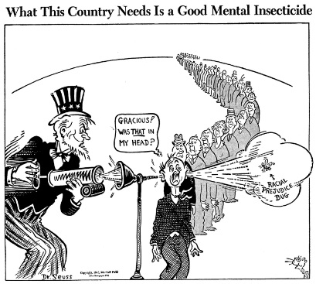
Conclusions
Latinos experience bias in the legal system. Legal decision making may play a role → disparities.
As the Latino population continues to increase, this area of research will continue to be noteworthy and needed.
Future research must focus on the means to reduce legal system bias and deliver equal justice under the law.
Notes:
Based on current legal bias and the increasing presence of Latinos in the US, finding solutions to legal system bias becomes ever more important.

Slide 35
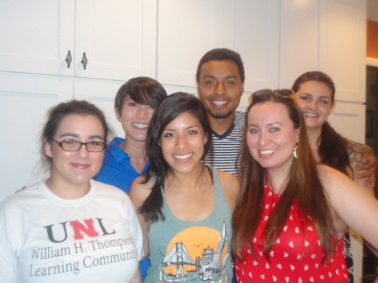
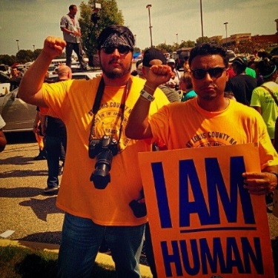
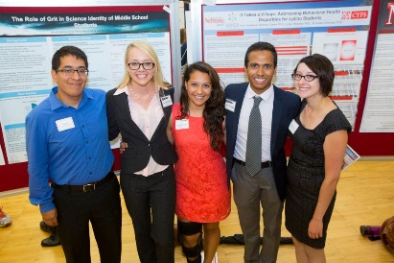
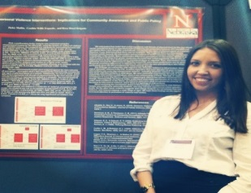
THANK YOU! GRACIAS!
Race and Ethnicity Psychology Lab
http://psychology.unl.edu/race-ethnicity-lab/race-and-ethnic-psychology-lab-information
Current/Past Graduate Students
Russ Espinoza, PHD
Leslie N. Davila Martinez, PHD
Rosa Hazel Delgado, MA
David Garcia
Jenna Perkins, MA, JD
Undergraduate Students
Karina Pedroza, BA Haley Mullin, BA Ivan Avila, BA
David Orozco Garcia, BA Leo Sierra, BA Lizette Osorio, BA
Elizabeth Sanchez Sydney Gaylord, BA Evette Trujillo, BA
Erandi Herndon, BA Rene Aranda, BA Tran Le, BA
Michael Wenzl Deanna Pena, BA Kim Ruiz
Juan Paulo Ramirez, PhD
School of Natural Resources - demography
Notes:
I have to thank past and current students who worked on some of this work with me.

